Slide 1
Shopping Trends

Slide 2
1. Business Problem

Slide 3

Business Problem
The shopping trends dataset encompasses key shopping metrics such as product categories, payment methods, seasons, gender, subscription status, and more
Conducting comprehensive Exploratory Data Analysis (EDA) on shopping data to identify trends, extract actionable insights, and develop data visualizations. These insights equip businesses with valuable information related to consumer shopping behavior, enabling them to make data-driven decisions and enhance operational strategies

Slide 4
2. Analysis and Findings

Slide 5
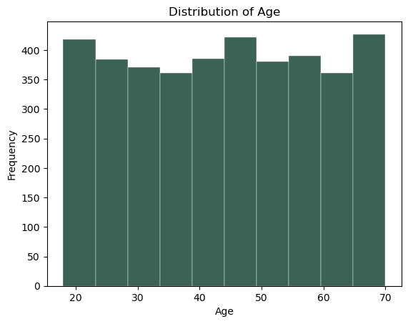
1. Distribution of Customer’s age
The chart shows a histogram representing the distribution of "Age."
The X-axis represents age groups, ranging from 20 to 70, with intervals of 10 years and the y-axis represents the frequency, or the count of occurrences for each age group.
Age Distribution: The age groups 20 and 70 have the highest frequency, both slightly above 400. The frequency for the other age groups remains somewhat consistent, fluctuating between 350 to 400.
There is no significant outlier or skewness in the age distribution, indicating a relatively uniform distribution across the age range.

Slide 6
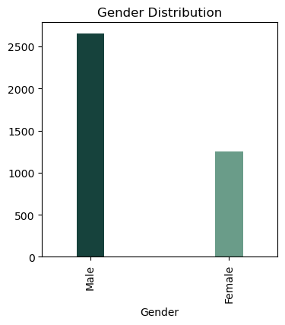
2. Gender wise Distribution
The chart represents the Gender Distribution using a bar plot
The x-axis represents the gender categories—Male and Female and the y-axis represents the count of occurrences for each gender.
The scale goes up to 2500+
Gender Distribution: The male count exceeds 2500, showing a significantly larger representation in the dataset and the female count is around 1250, which is approximately half the male count.

Slide 7
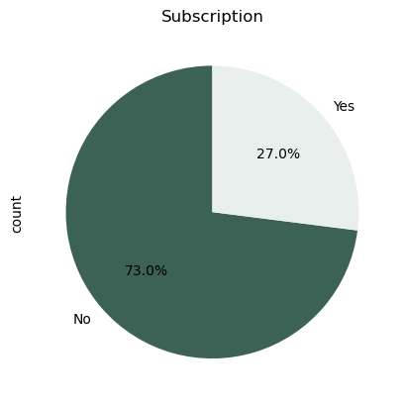
3. Subscription status
The chart is a pie chart representing Subscription status
Yes represents those who have a subscription and No represents those who do not
No: 73% of the total respondents do not have a subscription.
Yes: 27% of the respondents have a subscription.
This implies that the majority of the customers do not prefer subscriptions

Slide 8
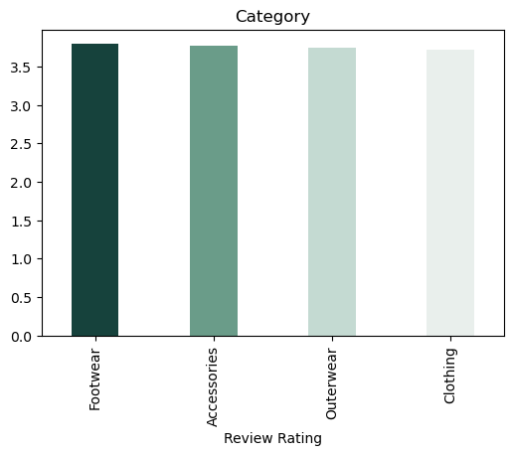
4. Category wise average review rating
The bar chart compares the average review ratings across four different product categories: Footwear, Accessories, Outerwear, and Clothing
Highest Average Review rating: Footwear has the highest average review rating, slightly above 3.5 and Accessories follows closely behind with a similar average rating
Lower Average Review rating: Outerwear is slightly lower than Accessories, but not by a significant margin and Clothing has the lowest average rating among all of them
The review ratings for all categories seem to hover around 3.5 out of 5. This indicates a moderate level of satisfaction among customers.

Slide 9
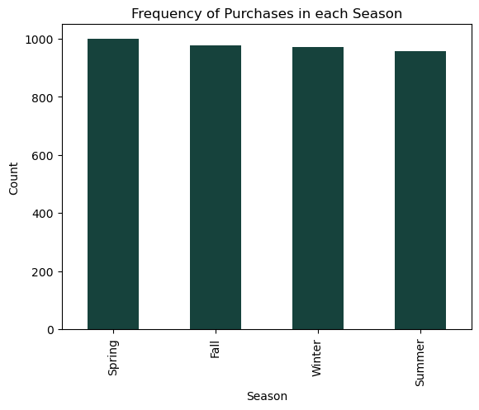
5. Frequency of Purchases across different seasons
The bar chart represents the frequency of purchase in different seasons like Spring, Fall, Winter and Summer
The bar heights are very similar across all seasons, indicating that the number of purchases in each season is relatively uniform, with only minor differences
Spring appears to have the highest frequency of purchases, just slightly above Fall and Winter and Summer seems to have the lowest number of purchases, though the difference is minimal compared to the other seasons
The relatively equal bar heights suggest there is no significant seasonality affecting purchases

Slide 10
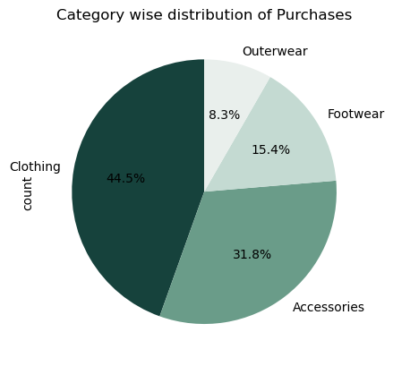
6. Category wise Purchase Distribution
The pie chart illustrates the category-wise distribution of purchases across four product categories namely Clothing, Accessories, Footwear, and Outerwear
Highest Purchasing category: The largest portion of purchases is attributed to the Clothing category, accounting for 44.5% of the total. This suggests that nearly half of the purchases fall under this category, making it the most popular
Second Highest Purchasing category: Accessories account for 31.8% of purchases making it the second- largest category, showing that accessories also play a significant role in sales
Moderate Purchasing Category: 15.4% of purchases are for Footwear, indicating moderate demand. This is a sizable portion but much smaller than Clothing and Accessories
Lowest Purchasing Category:8.3% of purchases fall into the Outerwear category, making it the least popular. The small percentage suggests that Outerwear is a less frequently purchased category compared to the others

Slide 11
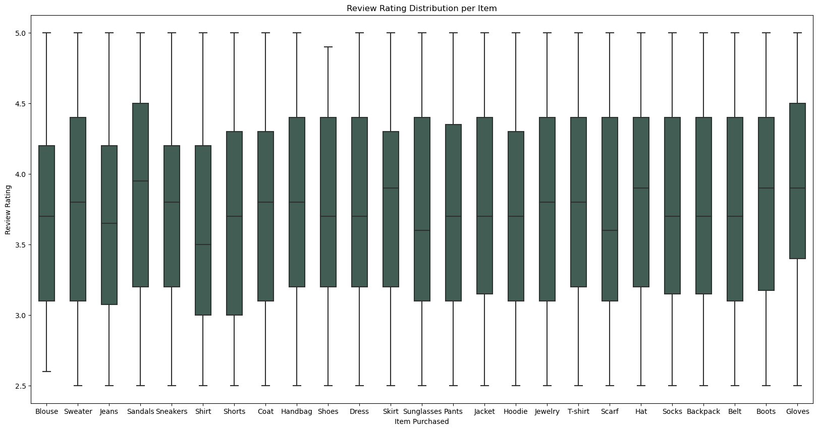
7. Review rating Distribution
The box plot shows the distribution of review ratings for various items. Most items have a rating distribution between 2.5 and 5.0
Each box represents the interquartile range (IQR), with the middle 50% of review ratings for each item type falling within this range. The whiskers extend to the minimum and maximum ratings, excluding any potential outliers
Most items have a median rating of around 4.0, indicating generally positive reviews
Sandals have a wider spread of ratings, with a lower median compared to other items. This could suggest some dissatisfaction or variability in the reviews
Sneakers, Shoes, and Coats have more compact IQRs, suggesting that their ratings are more consistent
Items like Blouse, Scarf, and Sunglasses show slightly lower medians, indicating more neutral reviews

Slide 12
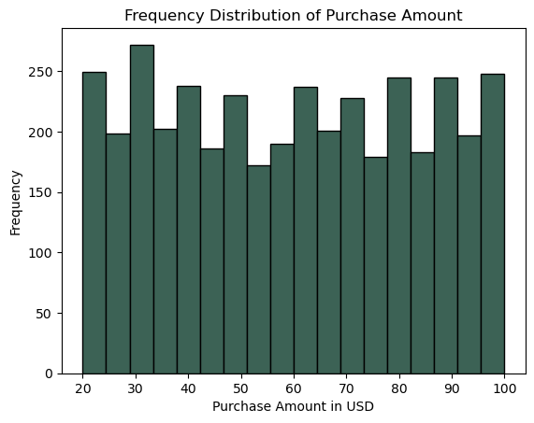
8. Distribution of Purchase amount
The histogram shows the frequency distribution of Purchase Amounts in USD
X axis shows the Purchase amounts grouped into bins
Y axis shows the frequency or how many transactions occurred within each purchase
The most frequent purchase amounts seem to fall in the 30-40 USD range, with the highest bar around this value, suggesting that a significant number of purchases fall within this range
The 20-30 USD and 90-100 USD ranges also show relatively higher frequencies, indicating that these are other common purchase amounts
There is a slight dip in the frequency around the 60-70 USD range, indicating fewer purchases at this level compared to other ranges
The fairly consistent height of most bars indicates that purchases are made across a wide range of amounts, without any extreme concentrations at particular price points, although there are slight preferences for certain ranges like 30-40 USD and 90-100 USD

Slide 13
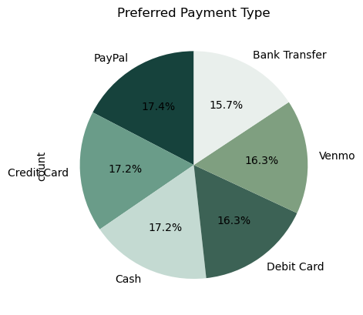
9. Preferred payment type
The pie chart displays the distribution of different payment types based on user preference
PayPal (17.4%) is the most preferred payment method, slightly ahead of the others
Credit Card and Cash (both 17.2%) are very close to PayPal, indicating that they are also highly favored by users
Venmo and Debit Card (both 16.3%) are just behind the top three, suggesting that while they are slightly less preferred, they are still widely used
Bank Transfer (15.7%) is the least preferred option, but the difference in preference is not significant compared to the other methods
Offering PayPal, Credit Card, Cash, and other digital payment solutions like Venmo might increase customer satisfaction
The slight edge of PayPal might suggest that digital payment platforms are becoming more popular, but traditional methods like Credit Card and Cash still hold strong positions

Slide 14
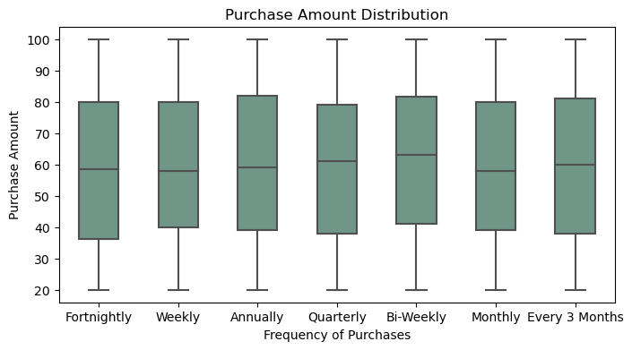
10. Purchase amount Distribution frequency
The box plot visualizes the distribution of purchase amounts across different frequencies of purchases, such as Fortnightly, Weekly, Annually, Quarterly, Bi-Weekly, Monthly, and Every 3 Months
The Box: Represents the interquartile range (IQR), which is the middle 50% of the data (from the 25th percentile to the 75th percentile)
The Line inside the Box: Represents the median (50th percentile)
The Whiskers: Extend to the minimum and maximum values within 1.5 times the IQR from the box
The median purchase amounts (represented by the horizontal line inside the boxes) appear similar across all purchase frequencies, hovering around the mid-50s to 60s range. This indicates that there is no strong skew in purchase amounts between the different frequencies
The interquartile ranges (the width of the boxes) are also quite consistent across all purchase frequencies, suggesting that the central 50% of purchase amounts doesn't vary much by purchase frequency
The whiskers show that the minimum and maximum purchase amounts are around 20 and 100 for most categories

Slide 15
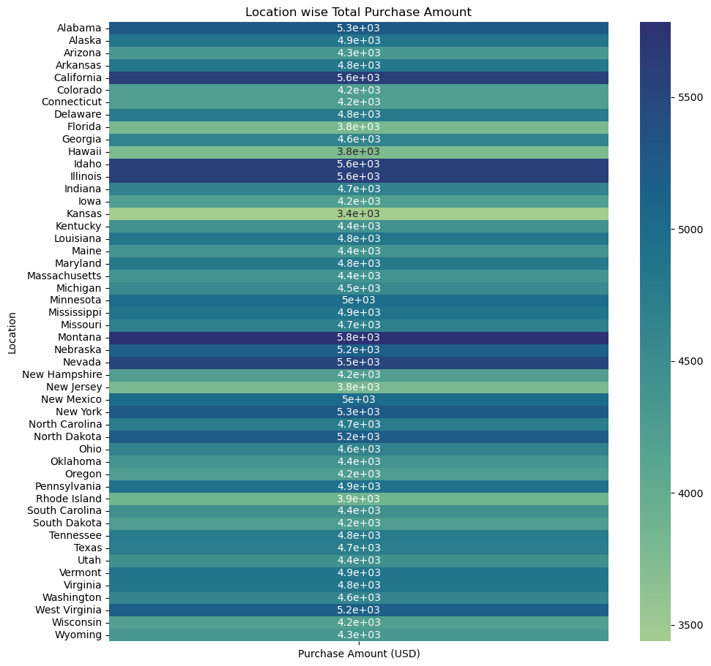
11. Locations having the Highest Purchase amount
The heatmap shows the total purchase amounts in USD for different U.S. states. Each state's total purchase amount is color-coded, and the color gradient on the right side of the chart indicates the purchase amounts from approximately 3500 USD to 5500 USD
Top States by Purchase Amount: California (5.6e+03) and Illinois (5.6e+03) stand out with the highest purchase amounts, indicating that customers in these states are spending the most. Montana (5.8e+03) also has a high purchase amount, slightly higher than California and Illinois. Nevada (5.5e+03) and Nebraska (5.2e+03) also show higher total purchase amounts.
Lowest Purchase Amounts: States such as Kansas (3.4e+03) and Florida (3.8e+03) have some of the lowest total purchase amounts, suggesting that customers in these states are spending less in comparison to other regions. Hawaii (3.8e+03) and New Jersey (3.8e+03) are also on the lower end of the spectrum.
Mid-Range States: Most states fall within the mid-range (around 4500 to 5000 USD). States like Minnesota (5e+03), New Mexico (5e+03), and New York (5.3e+03) are among these mid-level spenders.

Slide 16
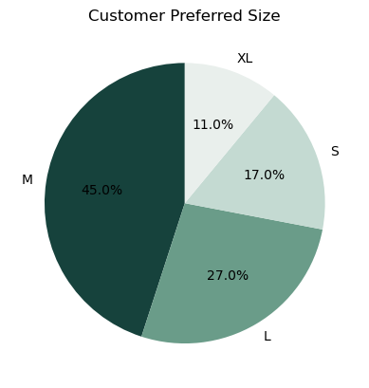
12. Customer Preferred size
The pie chart displays the customer preferences for different sizes like S,M,L and XL
The M (Medium) size is the most preferred, accounting for 45% of the total preferences. This indicates that nearly half of the customers prefer this size
L (Large) is the second most preferred size, with 27% of customers choosing it whereas S (Small) is preferred by 17% of customers and XL (Extra Large) is the least preferred size, accounting for only 11% of the preferences
Insights: Sizes M and L cover a significant majority of customer preferences (72%), which suggests that the stock for these sizes should be prioritized.
The demand for XL and S sizes is lower but should still be considered, especially for niche segments.
Since 45% of customers prefer the M (Medium) size, it’s essential to allocate a higher proportion of inventory to Medium-sized products to meet the high demand.
L (Large) is also significant, making up 27% of preferences, so it should have considerable stock levels, though less than Medium.
For S (Small) and XL (Extra Large), representing 17% and 11% of preferences respectively, smaller batches of stock should be maintained, but sufficient enough to meet niche demands

Slide 17
3. Insights and Recommendations

Slide 18
Insights and Recommendations
Develop targeted offers, discounts, or loyalty programs to encourage non-subscribers to opt for a subscription
Continue to focus on the clothing and footwear categories, as they have strong customer interest and satisfaction. Explore promotions or new product lines to maximize demand in these areas
Focus on improving customer satisfaction for items like sandals and blouses, which have shown lower ratings, by addressing quality concerns or offering better value
Ensure a broad range of payment methods, including digital and traditional options, to cater to the diverse preferences of the customer base. Offering a wide range of payment options could increase customer satisfaction.
Target high-spending regions like Montana, California, and Illinois with premium offers, while exploring ways to increase engagement in lower-spending regions like Kansas and Florida through pricing strategies, offers and discounts
Implement strategies to boost the sales of smaller segments like footwear and outerwear, such as seasonal promotions or expanding the product range
A large proportion (73%) of the dataset has not opted for a subscription, while only 27% have subscribed. This highlights a need to improve subscription rates

Slide 19
Thank You

